Slide 1
A brief introduction to
Dependent Types
Rafael Fernández Ortiz

Slide 2
What is a type?
We say that a term t has type T (or t belongs to T) when t is “obviously” evaluates to a value of the appropriate form.
For example:
1 has type Int
true has type Bool
if true then false else true has type Bool
if 1 then false else 3 has type ???
The typing relation t : T is defined by a set of inference rules assigning types to terms.
A term t is typable if there is some T such that t : T

Slide 3
Why are needed types?
Uniqueness of Types.
Each term t has most one type.
If t is typable, then its type is unique.
If t: T1 and exists T2 such that t:T2 ==> T1 = T2
Safety, well-typed terms do not “go wrong”.
Progress theorem:
If t is a well-typed term, then t is either a value or there is another term t’ such that t —> t’
Preservation theorem:
If t: T and t —> t’, then t’: T

Slide 4
Why are needed types?
Safety, well-typed terms do not “go wrong”.
Progress theorem:
b := true, is a value
b := if (1>0) true else false ⇒ there is another expression
if (1>0) true else false —>
if (true) true else false —>
true
Preservation theorem:
b := true, we know true has type Bool
b := if (1>0) true else false ⇒ we don’t know its type, but
true ⇒ has type Bool
Therefore, if (1>0) true else false has type Bool

Slide 5
Why are needed types?
Also
the Curry–Howard
isomorphism
(High Order Logic ⇔ Lambda Calculus + Type system)

Slide 6
What is a dependent type?
In a “usual” type system, values and types are fundamentally differents kinds of things that are related by the typing relationship.
In a dependent type system, types are allowed to depend on values.
Dependent types are types that depend on values
Example:
A list of numbers (List Int) is a type
A list of numbers whose length is bounded by some constant (List 4 Int), is a dependent type.

Slide 7
Why are needed dependent types?
We preserves the benefits of a usual type system
We can now be more restrictive in our software in the compile time

Slide 8



Dependent types vs Refinement types
They are not the same
Normal types
Refinement types
Dependent types

Slide 9
Idris
Idris is a general purpose functional programming language
Influenced by Haskell
Especially in the part of the syntax and types
Has full dependent types
No restriction on which values may appear in types
Allow a programmer to give more precise type
Created by Edwin Brady

Slide 10
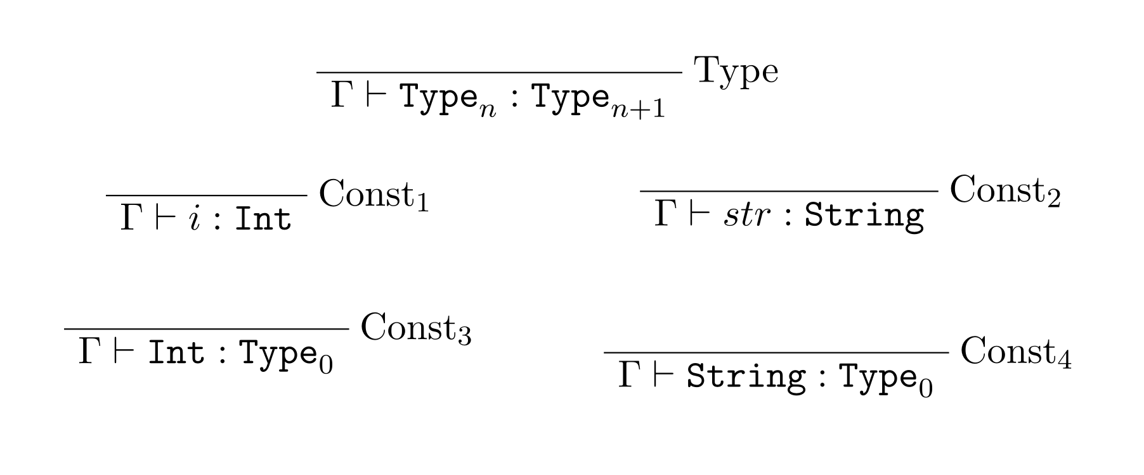
Idris

Slide 11
Idris
time to
POC

Slide 12
Scala
Scala2 has not a formal specification for dependent types
Scala2 has many ways to simulate them:
By using path-dependent types
By scratching types and hacking the type checker
Ref. Arithmetic using the Scala Type System
Scala3 has a tidy approach for dependent types
Ref. Scala3-dependent-types

Slide 13
Scala
time to
POC

Slide 14
Questions
time to
ASK

Slide 15
References
Types and programming languages. Benjamin C. Pierce
Idris, a general purpose dependently typed programming language: design and implementation. Edwin Brady
Type-Driven Development with Idris. Edwin Brady
Introduction to dependent types with idris. Boro Sitnikovski
Idris2-lang Documentation. https://www.idris-lang.org/
Idris2 by using devcontainer. joshuanianji/idris-2-docker

Slide 16
A brief introduction to
Dependent Types
Rafael Fernández Ortiz

